Slide 1
DIGITAL IMAGE PROCESSING
IMAGE FILTERING
1

Slide 2
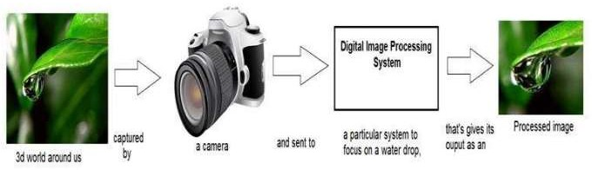
INTRODUCTION TO DIP
2

Slide 3
FILTERING
Filtering is a technique used for modifying or enhancing an image like highlight certain features or remove other features.
Image filtering include smoothing, sharpening, and edge enhancement
Term ‘convolution ‘ means applying filters to an image .
It may be applied in either
spatial domain
frequency domain.
3

Slide 4
SPATIAL DOMAIN FILTERS
4

Slide 5
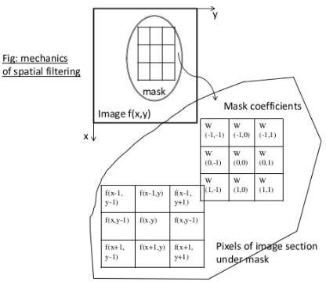
MECHANISM OF SPATIAL FILTERING
This process shows moving filter mask point to point
Filter at each point (x , y) are calculated by predefined relationship
5

Slide 6
LINEAR SPATIAL FILTERING
For Linear spatial filtering,
Result = sum of product of filter coefficient and the corresponding image pixels
For above figure Response R is
R = w(−1,−1)f(x-1, y -1) + w(-1,0)f(x-1, y)
+…..+ w(0,0)f(x, y) + …. + w(1,1)f(x+1, y +1)
w(0,0) -indicates mask is centered at x , y
R=result or response of linear filtering
6

Slide 7
LINEAR SPATIAL FILTERING
Linear filter of an image f of size M×N with a filter mask size of m × n is given by the expression
a
b
g ( x, y ) =
∑
∑ w( s,t ) f ( x+ s, y +t )
s=−a _{t =−b}

Slide 8
LINEAR SPATIAL FILTERING
For a mask of size=m × n
Assume that
m=2a+1
n=2b+1
Where a and b are nonnegative integers
Then m and n are odd.

Slide 9
CONVOLUTION
The process of linear filtering is same as convolution.
So linear spatial filtering is referred to as “convolving a mask
with an image.”

Slide 10
When interest lies on the response, R, of an m x n mask at any point (x , y), and not on the mechanics of implementing mask convolution
It is a simplified notation
R = w₁ z₁ + w₂ z₂
= ∑ w_{i} z_{i} i =1
...+ w_{mn} z_{mn}
mn

Slide 11
w1 | w2 | W3
w4 | w5 | w6
w7 | w8 | w9
For above 3 x 3 general Mask ,response at any point (x, y) in the image is given by
R = w₁ z₁ + w₂ z₂ + ... + w₉ z₉ = ∑ w_{i} z_{i}
i=1
9

Slide 12
SMOOTHING SPATIAL FILTERS
Smoothing filters are used for blurring and for noise reduction
Blurring is used in preprocessing steps, such as removal of small details from an image prior to (large) object extraction, and bridging of small gaps in lines or curves.
Noise reduction can be accomplished by blurring with a linear filter and also by non-linear filtering.

Slide 13
Smoothing spatial filter is done in two ways
Linear filters
operation performed on a pixel
Order statistics filter(non linear)
based on ranking on pixel

Slide 14
SMOOTHING LINEAR FILTERS
linear spatial filter is simply the average of contained in the neighborhood of the filter mask.
the pixels
These filters sometimes are called averaging filter
By replacing the value of every pixel in an image by the average of the gray levels in the neighborhood defined by the filter mask
This process results in an image with reduced “sharp”
transitions in gray levels

Slide 15
Two mask
averaging filter
weighted average

Slide 16
AVERAGING FILTER
A major use of averaging filters is in the reduction of “Irrelevant” detail in an image
A spatial averaging filter in which all coefficients are equal is sometimes called a box filter.
Also known as low pass filter.
m x n mask would have a normalizing constant equal to
1/ m n.

Slide 17
1 ×
9
AVERAGING FILTER
1 | 1 | 1
1 | 1 | 1
1 | 1 | 1
9
R = ¹ × ∑ z
9
1,
i =1

Slide 18
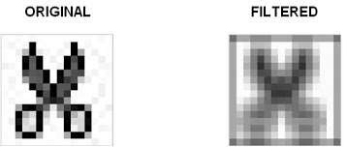
AVERAGING FILTER

Slide 19
WEIGHTED AVERAGING FILTER
Pixels are multiplied by different coefficients , the pixel at the center of the mask is multiplied by a higher value than any other, thus giving this pixel more importance in the calculation of the average.
The other pixels are inversely weighted as a function of their distance from the center of the mask

Slide 20
WEIGHTED AVERAGE
1 | 2 | 1
2 | 4 | 2
1 | 2 | 1
1 ×
16

Slide 21
The general implementation for filtering an M x N image with a weighted averaging filter of size
m x n (m and n odd) is given by the expression
∑ ∑ w(s, t ) f ( x + s, y + 1)
s =− at =− b
∑ ∑ w(s, t )
s =− at =−b
a b
g ( x, y) =
a b
21

Slide 22
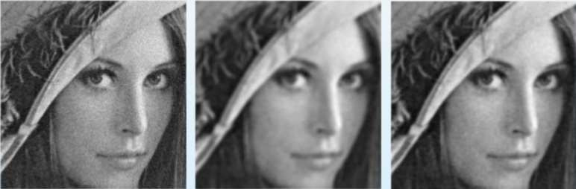
EXAMPLE OF WEIGHTED AVERAGING FILTER

Slide 23
ORDER STATISTICS FILTERS
Order-statistics filters are nonlinear spatial filters response is based on ordering (ranking) the pixels
whose
Example for this filter is median filter

Slide 24
MEDIAN FILTER
Median filters used for noise-reduction with less blurring than linear smoothing filters of similar size.
Median filters are particularly effective in the presence of impulse noise also called salt-and-pepper noise because of its appearance as white and black dots superimposed on an image.

Slide 25
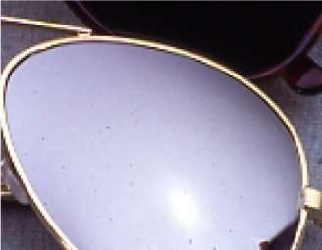
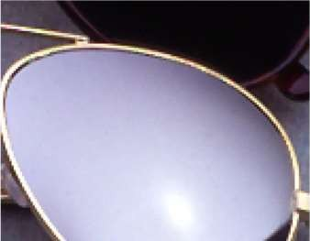
EXAMPLE FOR MEDIAN FILTER

Slide 26
FREQUENCY DOMAIN FILTERS

Slide 27
SMOOTHING FREQUENCY DOMAIN FILTERS
Smoothing is achieved by attenuating a specified range of high frequency component
The concept of filter in frequency domain is same as the concept of a mask in convolution.
G(u , v)=H(u , v)F(u , v)

Slide 28
SMOOTHING FREQUENCY DOMAIN FILTERS
After converting an image to frequency domain, some filters are applied in filtering process to perform different kind of processing on an image. The processing include blurring an image, sharpening an image etc,.
The three type of filters for these purposes are:
Ideal low pass filter
Butterworth low pass filter
Gaussian low pass filter

Slide 29
IDEAL LOW PASS FILTER
Low-pass filtering smooth a signal or image .
ideal low pass filter (ILPF) is one whose transfer function satisfies the relation
For cutoff frequency
H(u , v)= 1 if D(u , v) <
D₀
0 if D(u , v) > ^{D}0

Slide 30
D is a specified nonnegative quantity, and D(u, v) is the distance from point (u, v) in the frequency domain and the center of frequency rectangle
D(u, v) = [(u − M 2)² + (v − N 2)² ]¹²

Slide 31
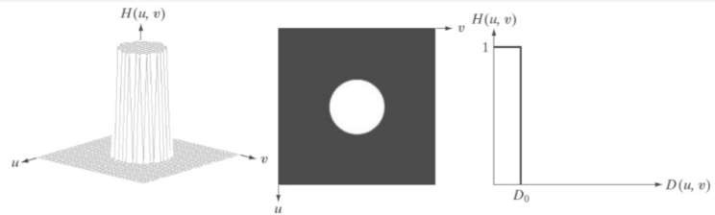
VISUALIZATION
Filter displayed as an image
Perspective plot of an ILPL Transfer function
Filter radical cross section
31

Slide 32
The low pass filters are radially symmetric about the origin
The complete filter transfer function can then be generated by rotating the cross section 360 about the origin
For an ideal low pass filter cross section, the point of transition between H(u, v) = 1 and H(u, v) = 0 is often called the cutoff frequency
The sharp cutoff frequencies of an ideal low pass filter cannot be realized with electronic components , although they can certainly be simulated in a computer.

Slide 33
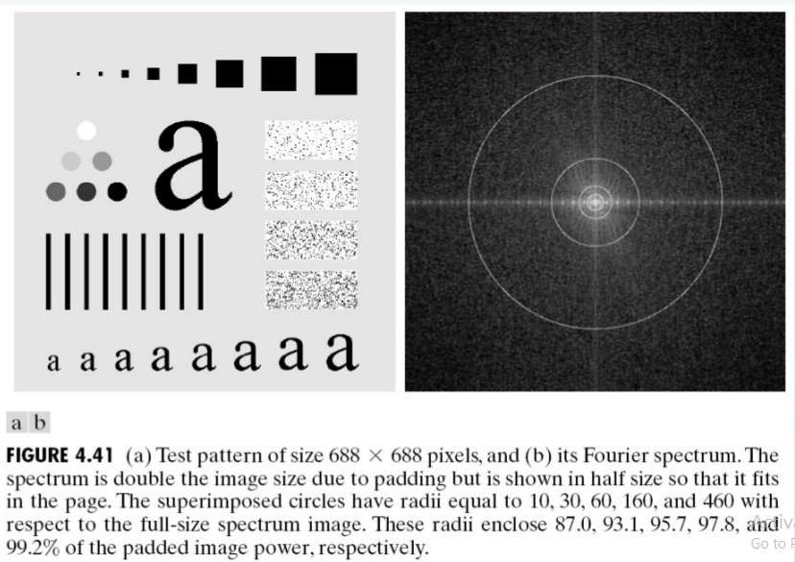

Slide 34
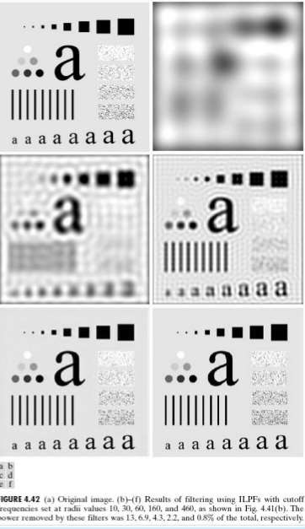
APPLYING ILPF TO A IMAGE IN DIFFERENT FREQUENCIES

Slide 35
BUTTERWORTH FILTER
The transfer function of the Butterworth low pass (BLPF) of order n and with cutoff frequency locus at a distance Do, from the origin is defined by the relation.
1
H (u, v) =
]2 n
1 + [D(u, v) / D₀
BLPF transfer function does not have a sharp discontinuity that establishes a clear cutoff between passed and filtered frequencies

Slide 36
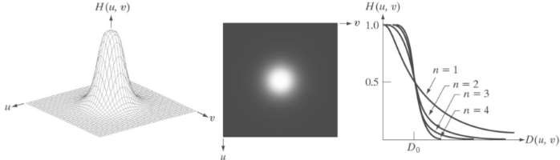
BUTTERWORTH LOW PASS FILTER
Filter displayed as an image
Perspective plot of an BLPF Transfer function
Filter radical cross section
36

Slide 37
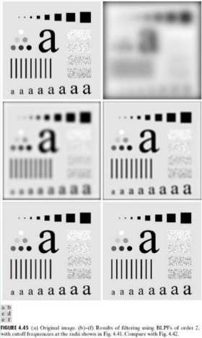
APPLYING BLPF IN AN IMAGE IN DIFFERENT FREQUENCIES

Slide 38
GAUSSIAN IMAGE FILTERING
The form of these filters in two dimensions is given by
2 2
_{H(u,v) = e}−D (u,v)/ 2σ
D(u, v) is the distance from the origin of the Fourier
transform.
σ is a measure of the spread of the Gaussian curve

Slide 39
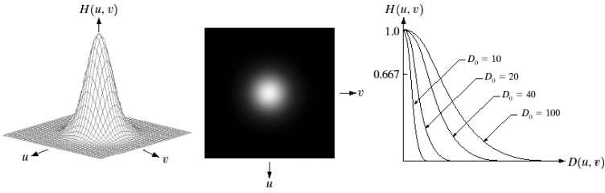
GAUSSIAN LOW PASS FILTERS
Filter displayed as an image
Perspective plot of an GLPF Transfer function
Filter radical cross section
39

Slide 40
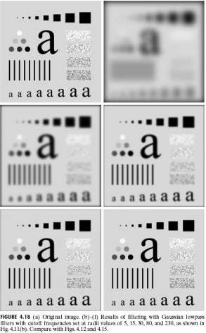
APPLYING GLPF IN AN IMAGE IN DIFFERENT FREQUENCIES
40

Slide 41
SHARPENING FREQUENCY DOMAIN FILTERS
Image sharpening is done by using high pass filters
It attenuates the low frequency components without disturbing high frequency information
The transformation of high pass function is
H_{hp} (u, v) = 1− H_{lp} (u, v)
^{H} hp
represents high pass function
^{H} lp Represents low pass function
41

Slide 42
Sharpening frequency domain filters include
Ideal low pass filter
Butterworth low pass filter
Gaussian low pass filter

Slide 43
Sharpening technique is reverse operation of low pass filters
When the low pass filters attenuates frequencies , the high pass filter passes them
When the high pass filters attenuates frequencies , the low
pass filter passes them

Slide 44
IDEAL HIGH PASS FILTER
It is defined as
H(u , v)= 1
if D(u , v) < D₀
0 if D(u , v) > D₀
Ideal high pass shows significant ringing artifacts

Slide 45
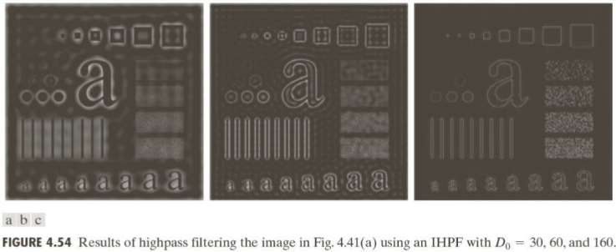

Slide 46
BUTTERWORTH HIGH PASS FILTER
Transformation function of BHPF
1
H (u, v) = 1−
]2n
1+ [D(u, v) / D
0
BHPF shows sharp edges with minor ringing artifacts

Slide 47
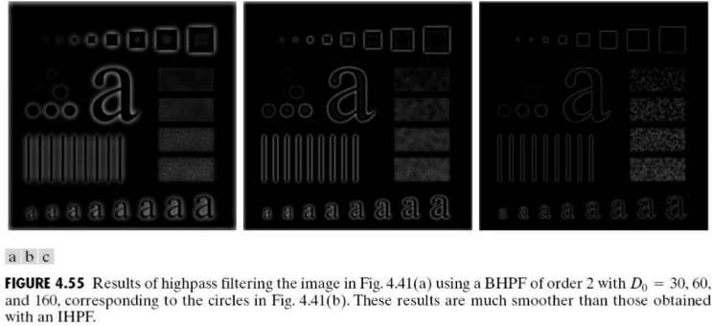

Slide 48
GAUSSIAN HIGH PASS FILTER
Transformation function of GHPF
2 2
_{H(u,v) =1− e}−D (u,v)/ 2σ
Gaussian high pass filters shows high sharpness without ringing artifacts.

Slide 49
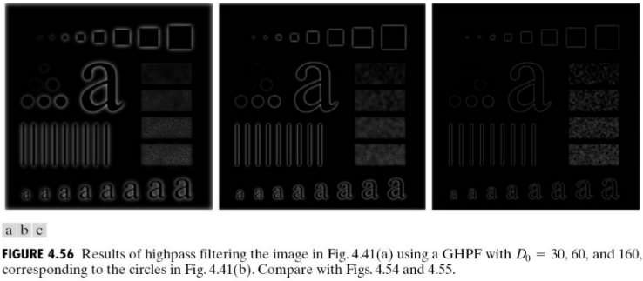

Slide 50
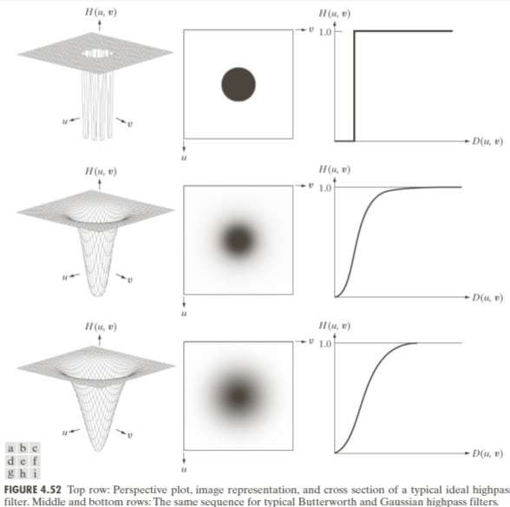
PERSPECTIVE PLOT , IMAGE REPRESENTATION AND CROSS SECTION OF IHPF,BHPF,GHPF

Slide 51
THANK YOU

